Slide 1
Review Analyzer and Summarizer
B.Tech Final Year Project
Group 7
MUHAMMED SHAMIL MP
BONNY B
ATHUL KRISHNA PA
MUHAMMED AFLAH K

Slide 2
TOC
Introduction
Objective
Proposed System
Activity Diagram
Block Diagram
Project Timeline
Conclusion

Slide 3
Introduction
Review text by public contains valuable knowledge, opinions, preferences, important for employers to make trading decisions.
Taking the review text of crowdsourcing participants on the Google Maps,Amazon and other platform as the data set to extract text features.
The wanted data from this huge stack of data is not often easy to sort.

Slide 4
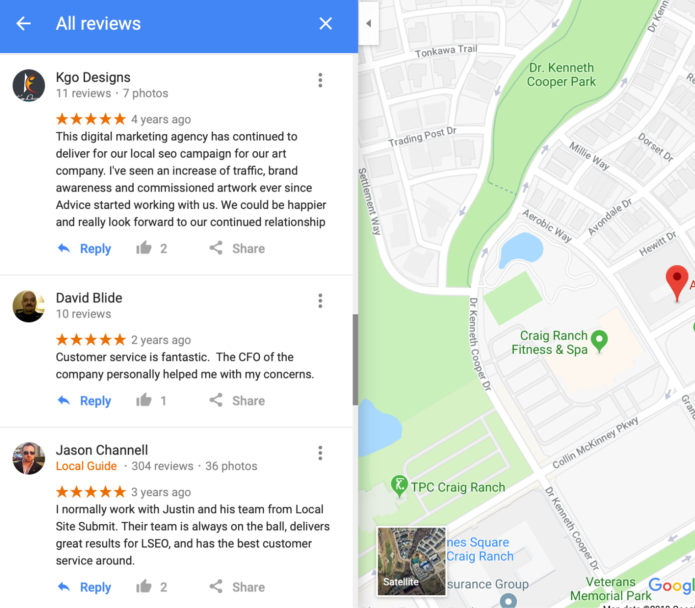
Objective
It is impractical to read all the reviews and analyse.
Introducing a summarised analysis of all the reviews about any place or products.
Large corpus of reviews accessible, explorable and digestible for the business as well as non-business purposes can be made.

Slide 5
We intend to analyse all the reviews and find the mostly discussed positive and negative qualities about that place or object.
Our NLP project will be universal i.e all types of reviews (google maps places reviews, amazon reviews, movie reviews etc) can be digested to produce result.

Slide 6



Target audience
Local tourists who plans to know about a place .
People who wants to gather information about a place or object.
People who needs to choose between places or services or products.
The business owners who wants to evaluate their business.

Slide 7
Proposed System
The proposed system is a review text analyzer.
The input is dataset of reviews of a location or item in Google Maps or amazon etc.
The reviews about that location or item is collected and it is processed.
The output is the details and summary of the reviews about that place, specifically the best and worst qualities.

Slide 8
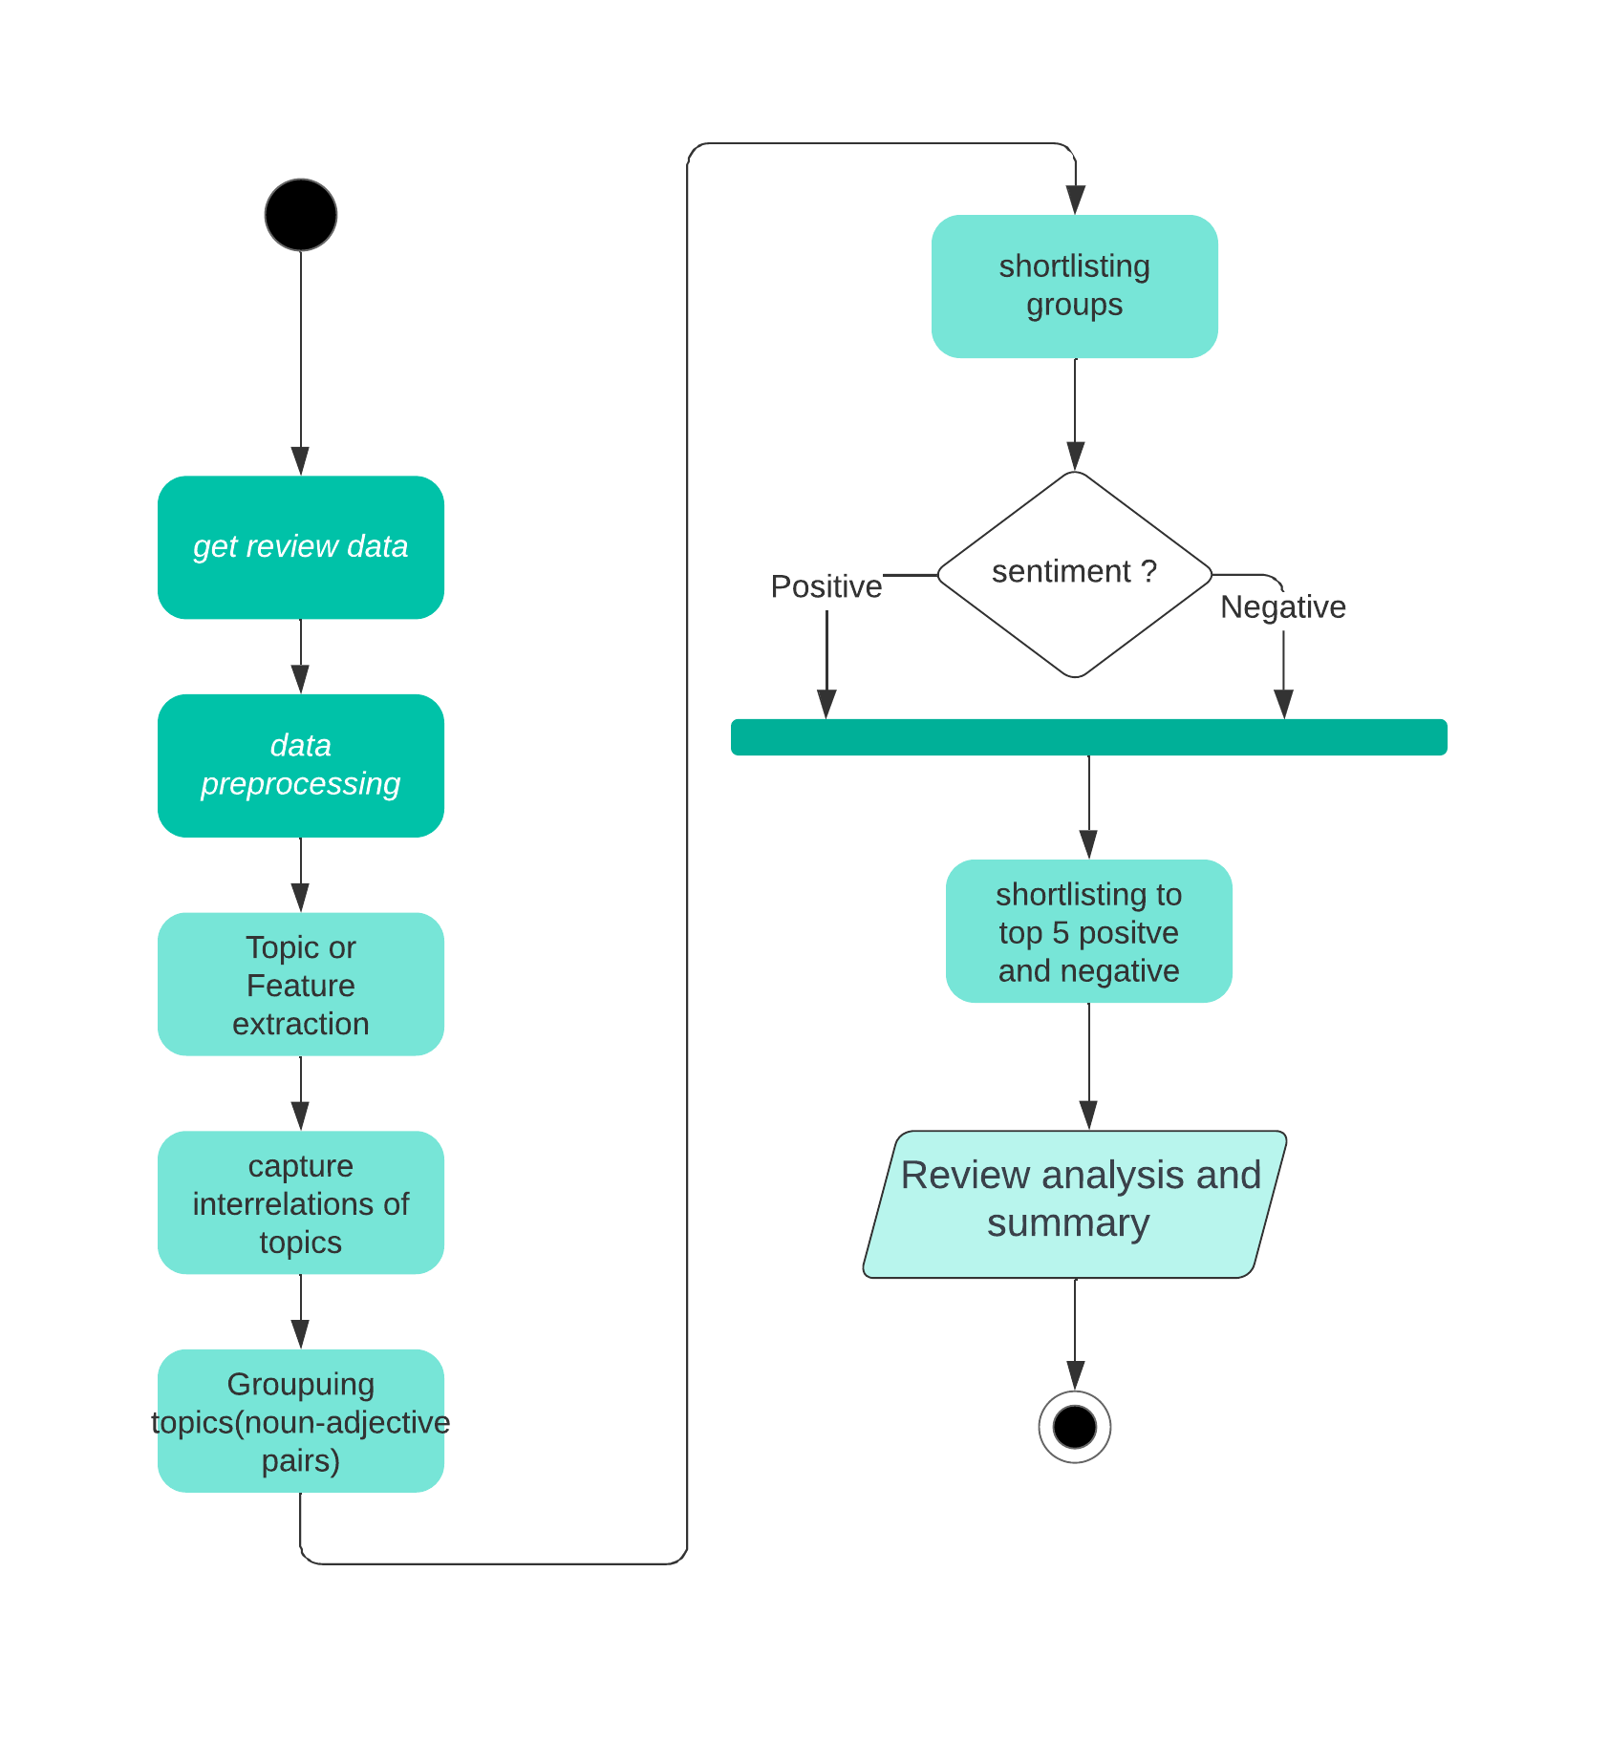
Activity Diagram

Slide 9
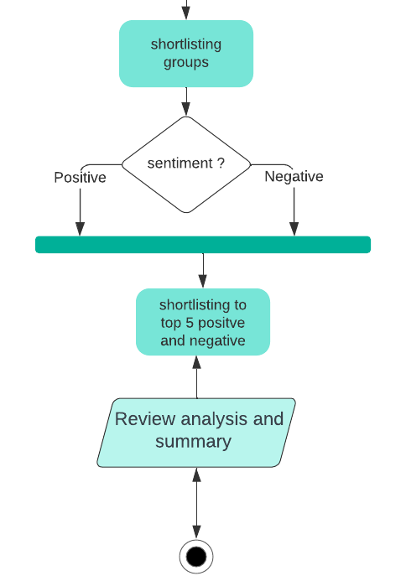
Activity Diagram

Slide 10
Block Diagram
Review data
Shortlisting topics
Sentence splitting
Capturing interrelations
POS Tagging
Sentiment Classification
Topics extraction
Output

Slide 11
The Plan
Analyzing reviews using NLP(natural language processing).
Topic extraction
Capture Interrelations
Sentiment Analysis
Getting the topics or features required for the project
Capture Interrelations between topics
Detect the opinion or sentiment on each topic.

Slide 12
Pre Processing
Make text lowercase
Part-of-Speech (POS) Tags
Stop Word Removal
Remove emoji’s
Lemmatization

Slide 13
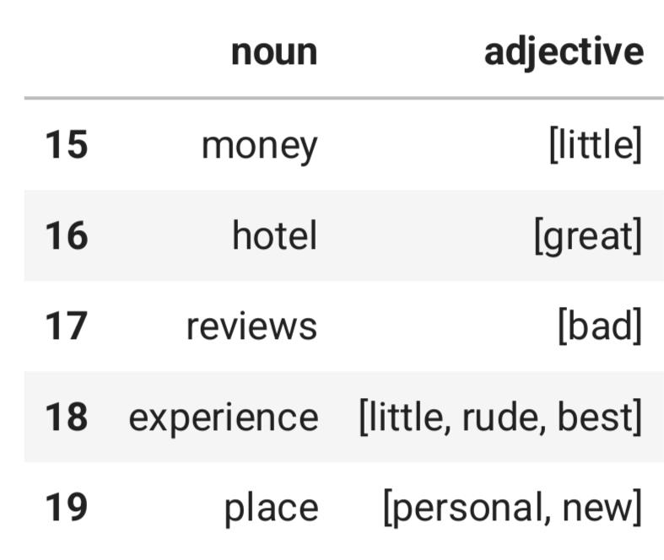
Topic Extraction
Qualities are mostly nouns and they are described by adjectives.
We use this semantic feature of the natural language to extract topics.

Slide 14
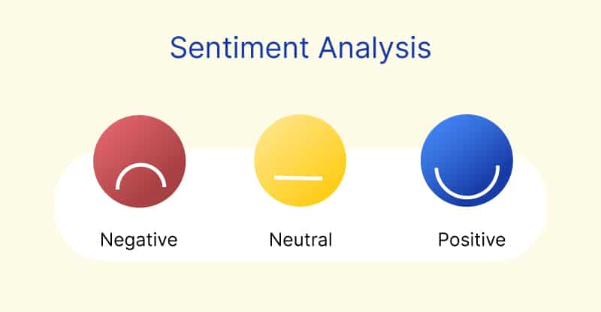
Sentiment Analysis
['bottle', 'glass', 'drink', 'champagne', 'beer', 'vodka', 'jar', 'bottles', 'dispenser', 'glasses']
sentiment : 0.7783
['drinks', 'coffee', 'snacks', 'beverages', 'cocktails', 'juice', 'alcohol', 'smoothies', 'drinkers']
sentiment : 0.9612
['shops', 'restaurants', 'shop', 'eateries', 'stalls', 'stores', 'boutiques', 'establishments', 'outlets', 'cafes']
sentiment : 0.9618

Slide 15
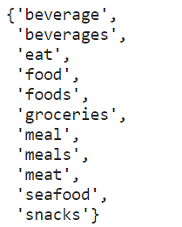
Capturing Interrelations
To capture the similar words groups we use google’s word2vec embedding.
similarity()

Slide 16
Methodology
Data Gathering
POS Tagging
Topic Extraction
Capture Interrelations
Sentiment Analysis
Collecting the review data and giving it as input.
Parts of speech tagging is useful in analysing the syntactic and semantic meaning of sentence.
Extracting topics or features
Capture Interrelations between topics.
Word2vec and cosine similarity.
Detect the opinion of each topic extracted.
Classify them as positive or negative.

Slide 17
OUTPUT

Slide 18
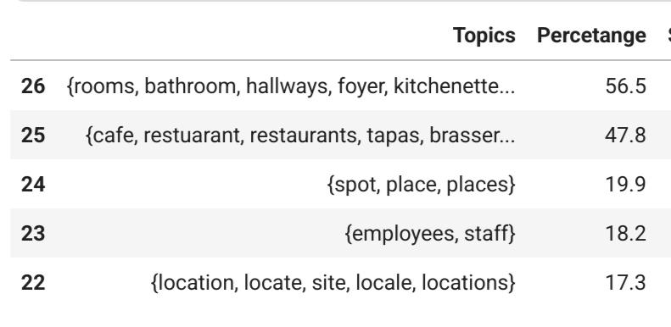
Top positive qualities

Slide 19
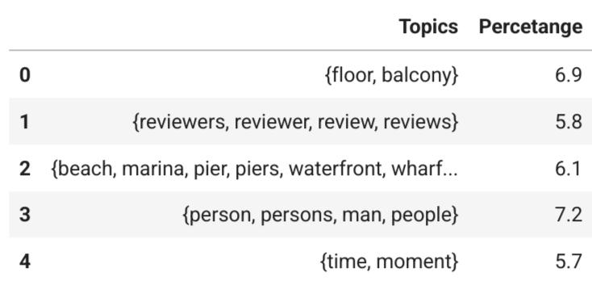
Top negative qualities

Slide 20
Future Scope
Use API for data collection.
Webapp with live data.

Slide 21
Project Timeline
Data collection
2nd half February
Topic Extraction
2nd half March
Sentiment Analysis
2nd half April
Data Preprocessing
1st half March
Shortlisting Topics
1st half April
Final Output
1st half May

Slide 22
Conclusion
A lot of studies in feature extraction, POS tagging and analysing text.
No projects are done on finding specific phrases , here , positive (what are the best things ) and negative qualities (what are the things to improve ) of a place.
By combining and using existing NLP techniques such as topic modelling POS tagging,,word2Vec, sentiment analysis etc , this can be achieved.

Slide 23
Reference
[1] Z. Rui and H. Yutai, ”Research on Short Text Classification Based on Word2Vec Microblog,” 2020 International Conference on Computer Science and Management Technology (ICCSMT), Shanghai, China, 2020, pp. 178-182, doi: 10.1109/ICCSMT51754.2020.00042.
[2] Gottipati S, Shankararaman V, Lin JR. Text analytics approach to extract course improvement suggestions from students’ feedback. Research and Practice in Technology Enhanced Learning. 2018 ;13(1):6. DOI: 10.1186/s41039-018-0073- 0. PMID: 30595737; PMCID: PMC6294207.
[3]M. R. Hasan, M. Maliha and M. Arifuzzaman, ”Sentiment Analysis with NLP on Twitter Data,” 2019 International Conference on Computer, Communication, Chemical, Materials and Electronic Engineering (IC4ME2), Rajshahi, Bangladesh, 2019, pp. 1-4, doi: 10.1109/IC4ME247184.2019.9036670.

Slide 24

Thanks

